Slide 1
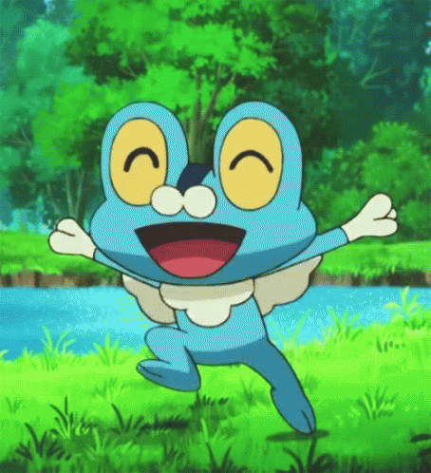

Slide 2
Story Time Let’s read aloud!!!!

Slide 3
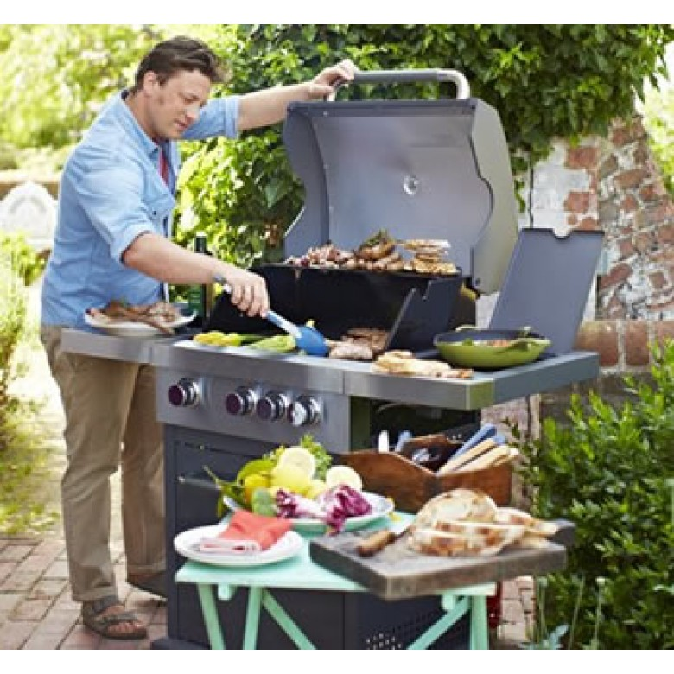
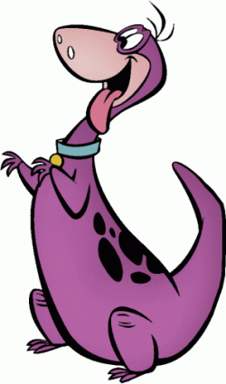
I want some bread and some hot dogs.
What do you want, Dino?

Slide 4
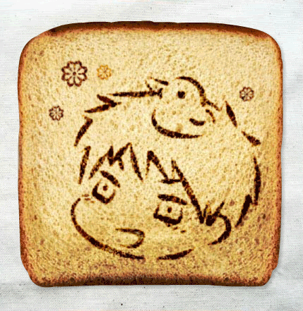
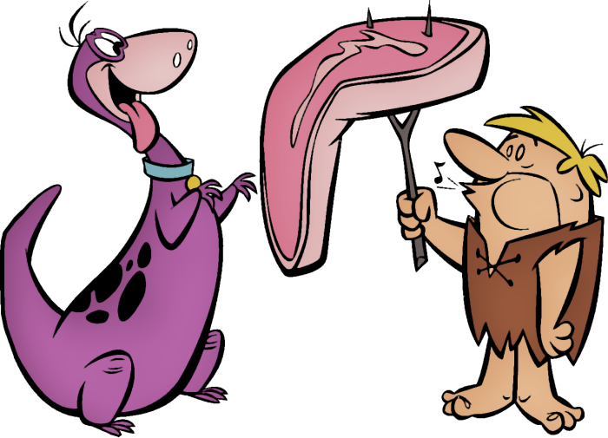
Mmm...Yummy!

Slide 5
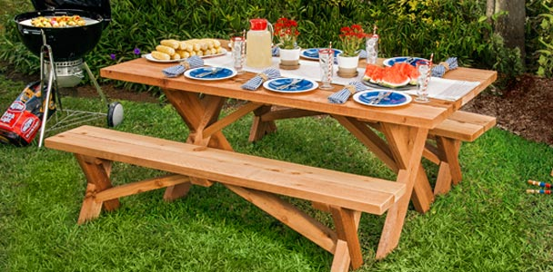
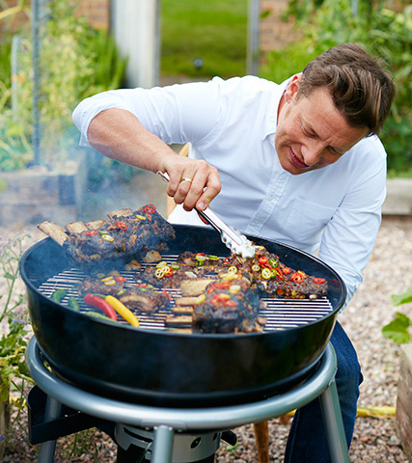
Of course he is.
Your brother is a good cook.

Slide 6
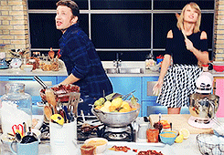
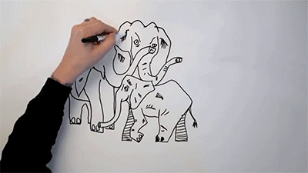
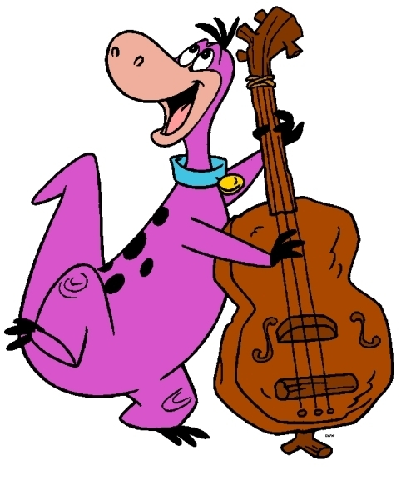
Me, too.
He can sing and draw, too.

Slide 7
a

Slide 8
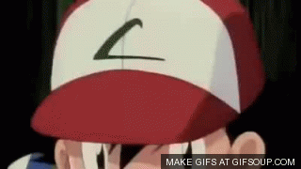
c
p
a

Slide 9
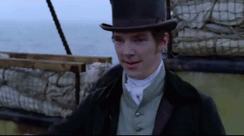
h
t
a

Slide 10
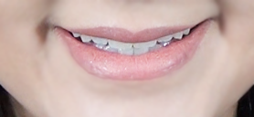
a
e

Slide 11
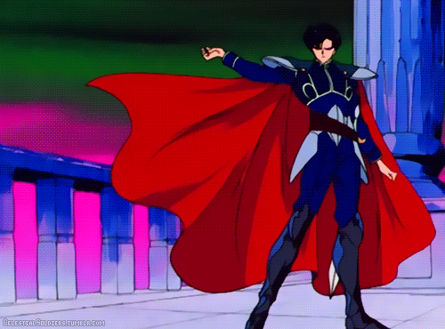
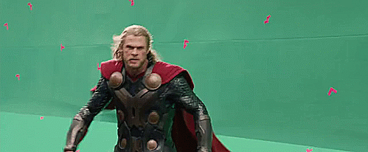
c
p
a
e

Slide 12
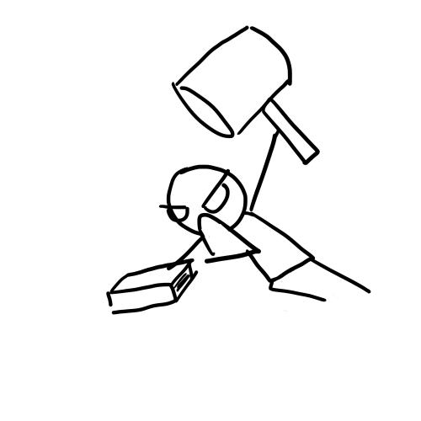
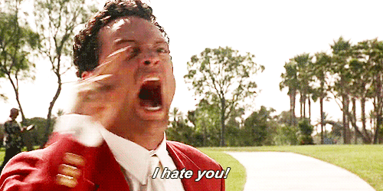
h
t
a
e

Slide 13
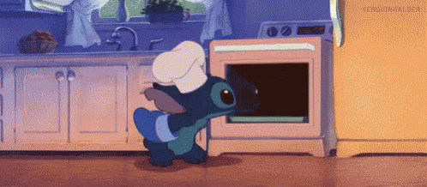
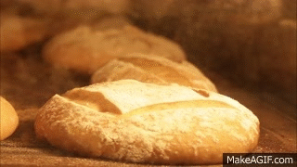
b
k
a
e

Slide 14
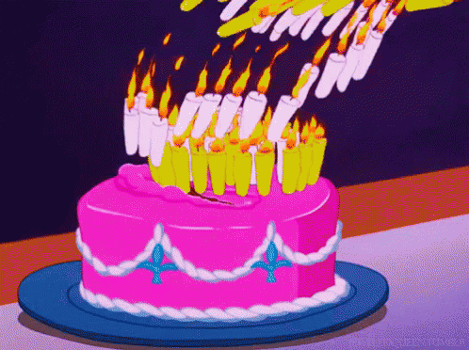
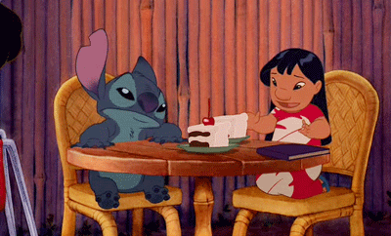
c
k
a
e

Slide 15
This is a cape.
That is a hat.
I like the cape.
I hate the hat.

Slide 16
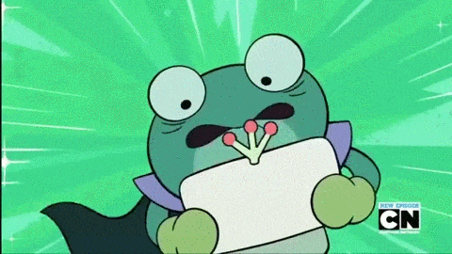
Numbers

Slide 17
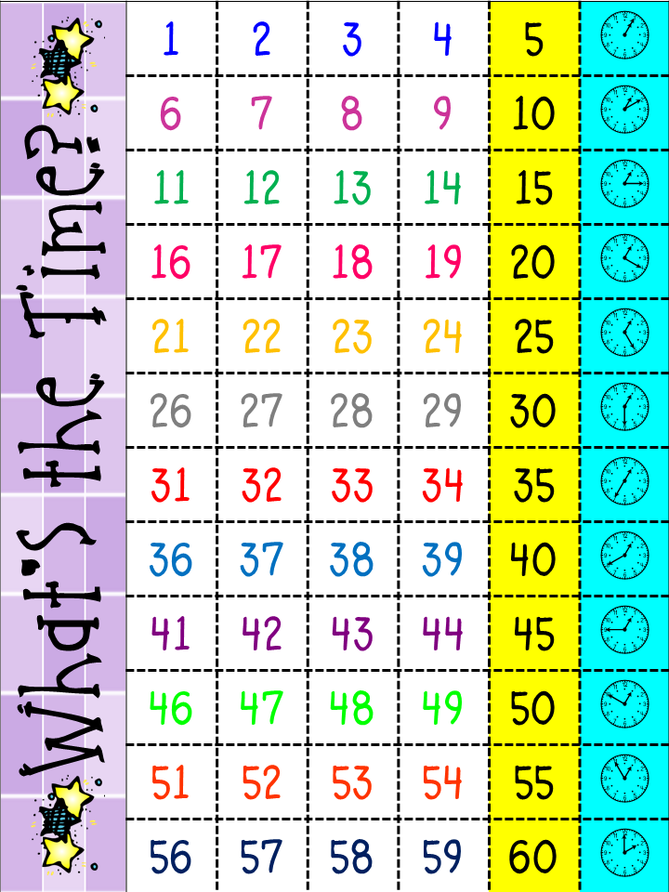
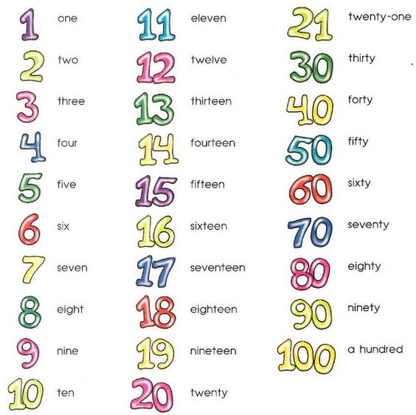
一定要先會!!!!!!

Slide 18
____teen
____ty

Slide 19
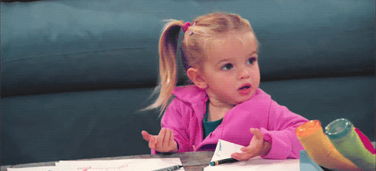
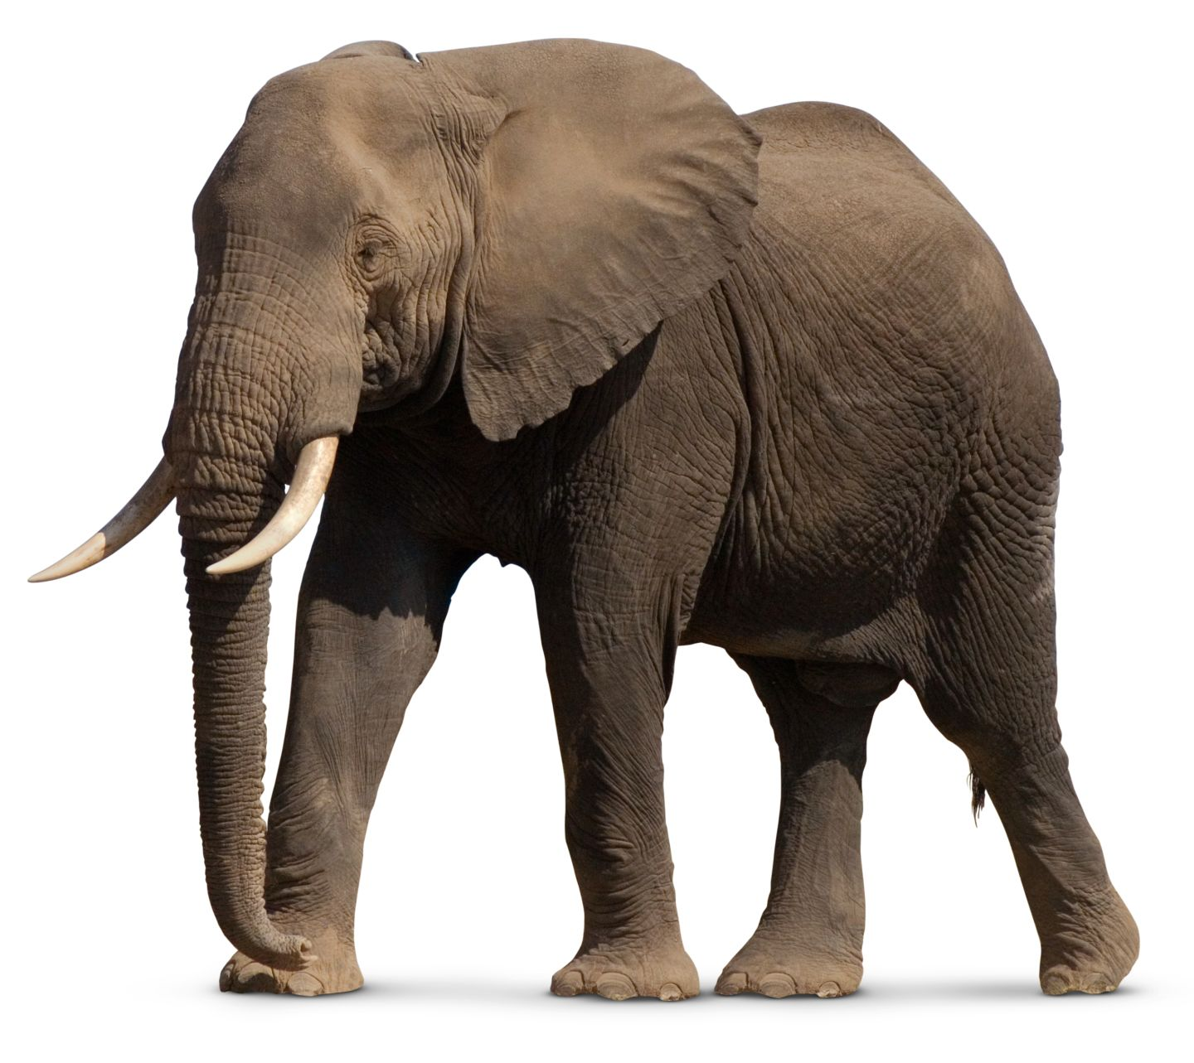
Easily confused
eleven V.S elephant
twelve V.S twenty

Slide 20
Group Challenge

Slide 21
How to say…?

Slide 22
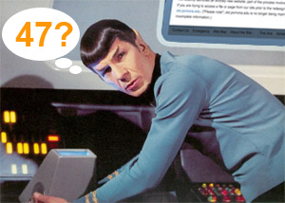
How to say…?

Slide 23
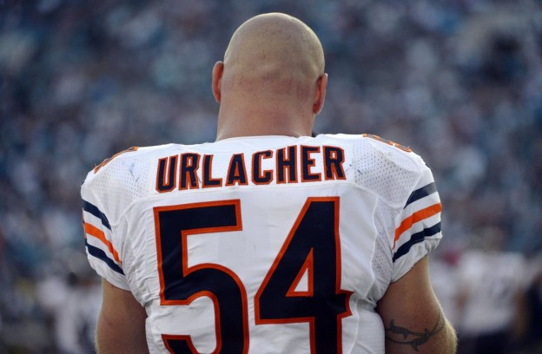
How to say…?

Slide 24
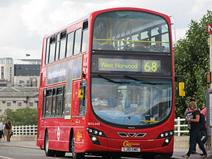
How to say…?

Slide 25
How to say…?

Slide 26
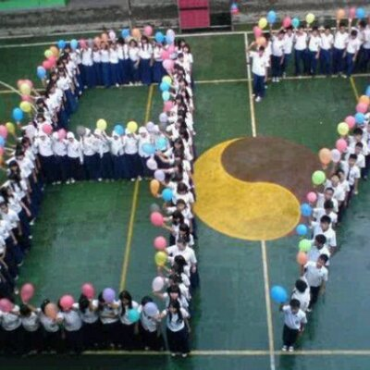
How to say…?

Slide 27
How to write…?

Slide 28
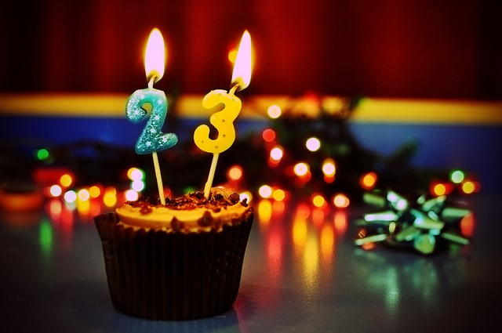
How to write…?

Slide 29
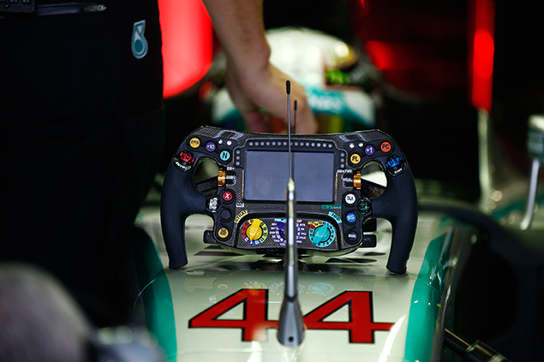
How to write…?

Slide 30
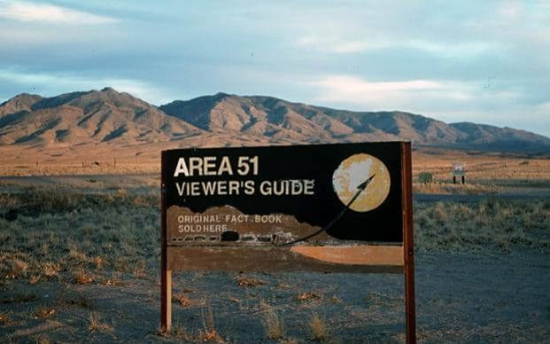
How to write…?

Slide 31
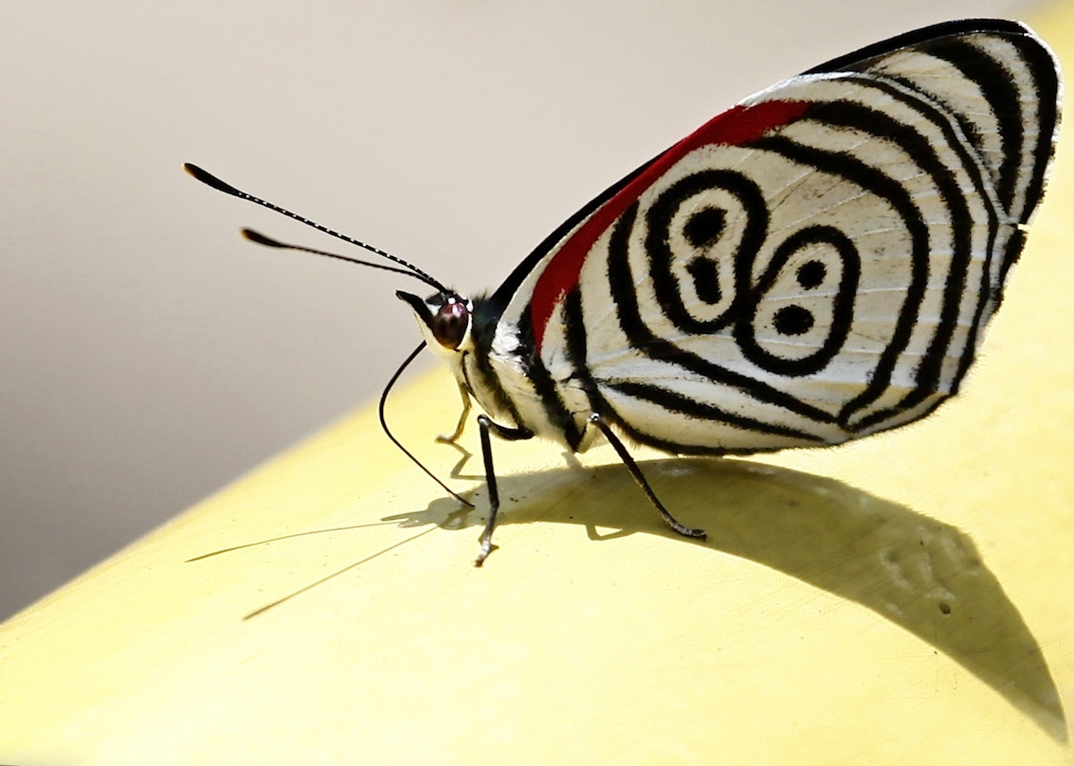
How to write…?

Slide 32
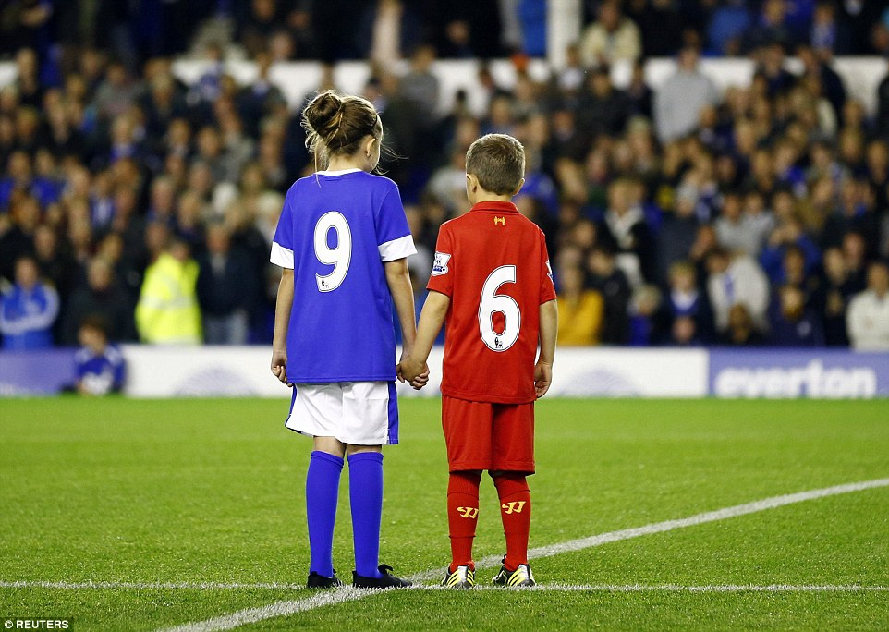
How to write…?

Slide 33
【第三週英語作業】
聽: CD1(第23~29首)，每聽3遍請家長簽一次名。
背:下週英語課進行小考。
寫:完成英語習寫簿黏貼的學習單。

